Slide 1

Quantum Computing
Implementation of the Lumped-Oscillator Model (LOM) on a Tunable Coupler for Superconducting Qubits
Supervised by Prof. Abdallah Sayyed’ Ahmad
Sarah Basem Dweik
11th January 2025

Slide 2
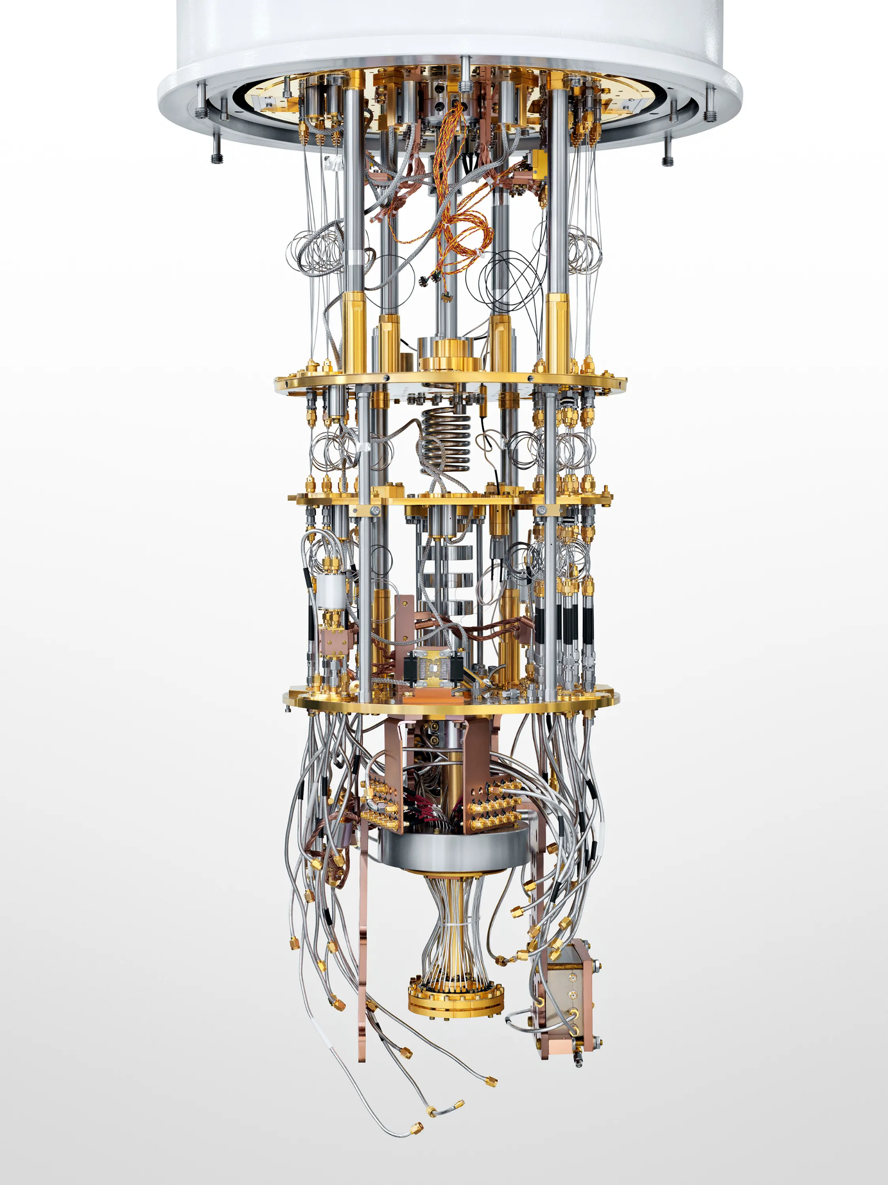


Slide 3
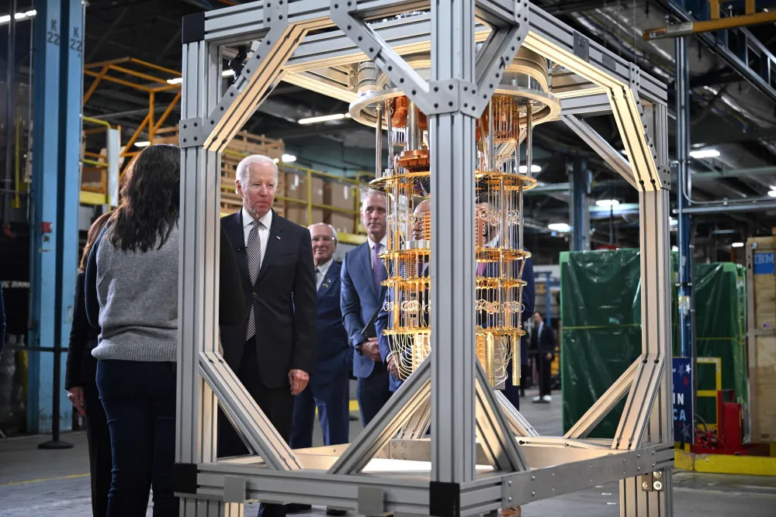
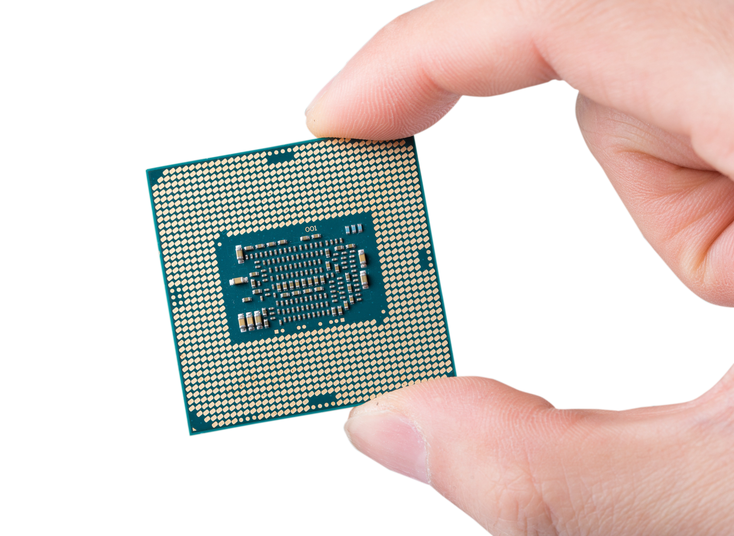
Design
Simulate
Fabricate
Image source: Foreign Policy (FP). (2023). Retrieved from bit.ly/4iYrKSq

Slide 4
DiVincenzo’s criteria
Well-defined qubits
Initialization to a pure state
Universal set of quantum gates
Qubit-specific measurement
Long coherence times

Slide 5
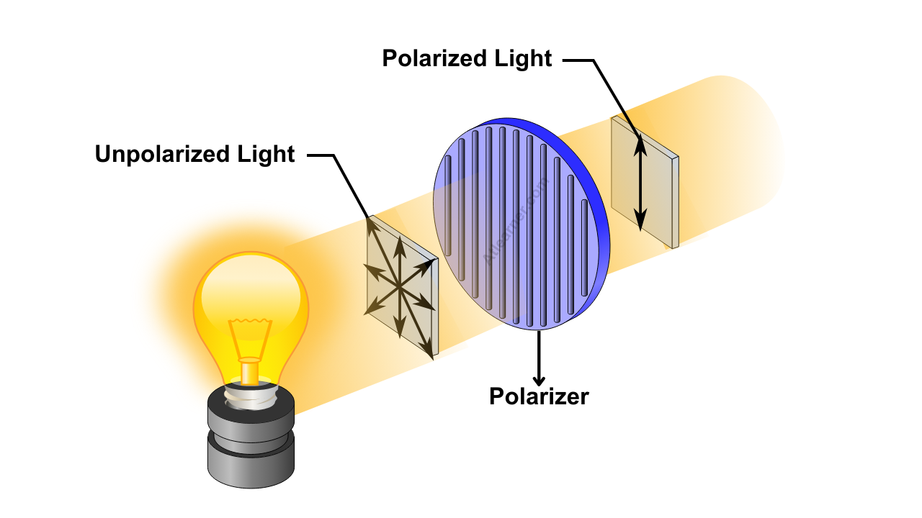
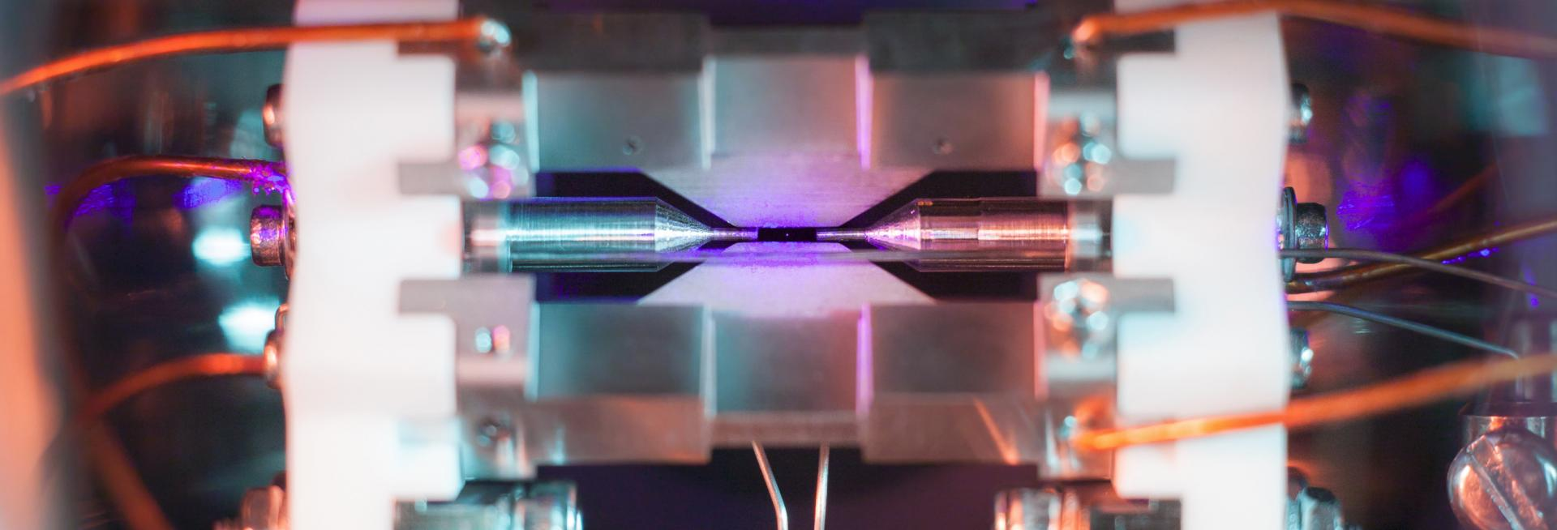
Quantum Computer Types
Ion Trap
Superconductores
Photonics
Phase Qubit
Charge Qubit

Slide 6

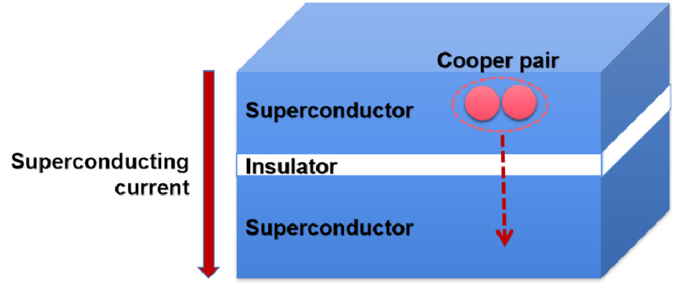
Josephson Junction

Slide 7
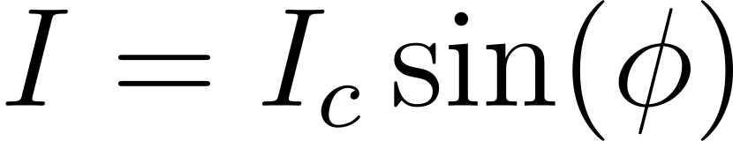
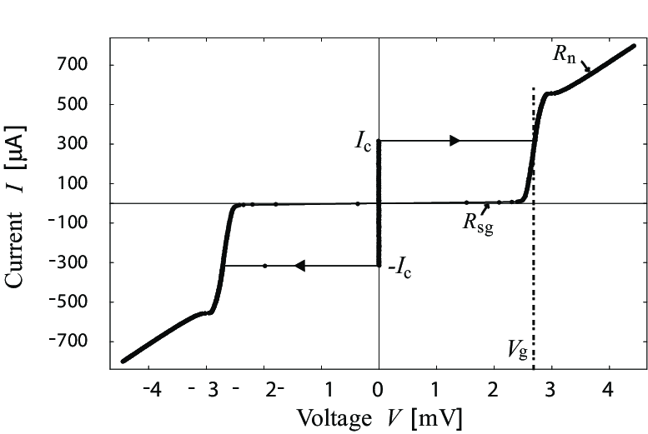
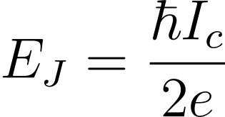
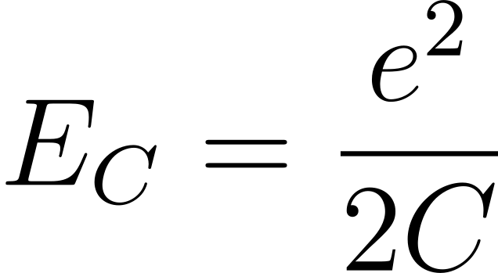
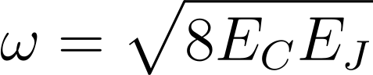
Lisenfeld, Jürgen. Experiments on superconducting Josephson phase quantum bits /.

Slide 8
Advantages Of Superconducting Quantum Computing
High designability
Scalability
Mangable control
Coupling Flexibility

Slide 9
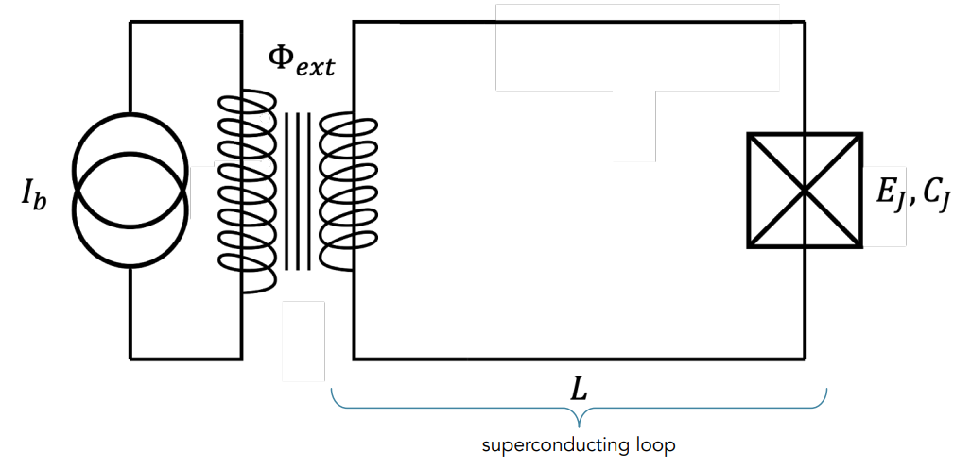
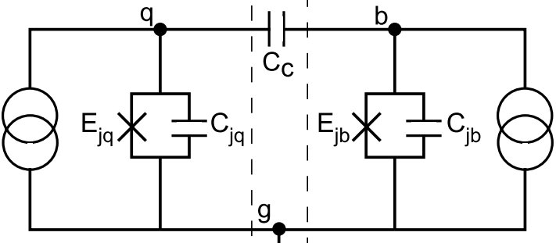
Research Statements
Qubit-Qubit coupling poses a significant challenge in scaling superconducting quantum computers, particularly with fixed couplers, where frequency-crowding and Cross-Talk occur.

Slide 10
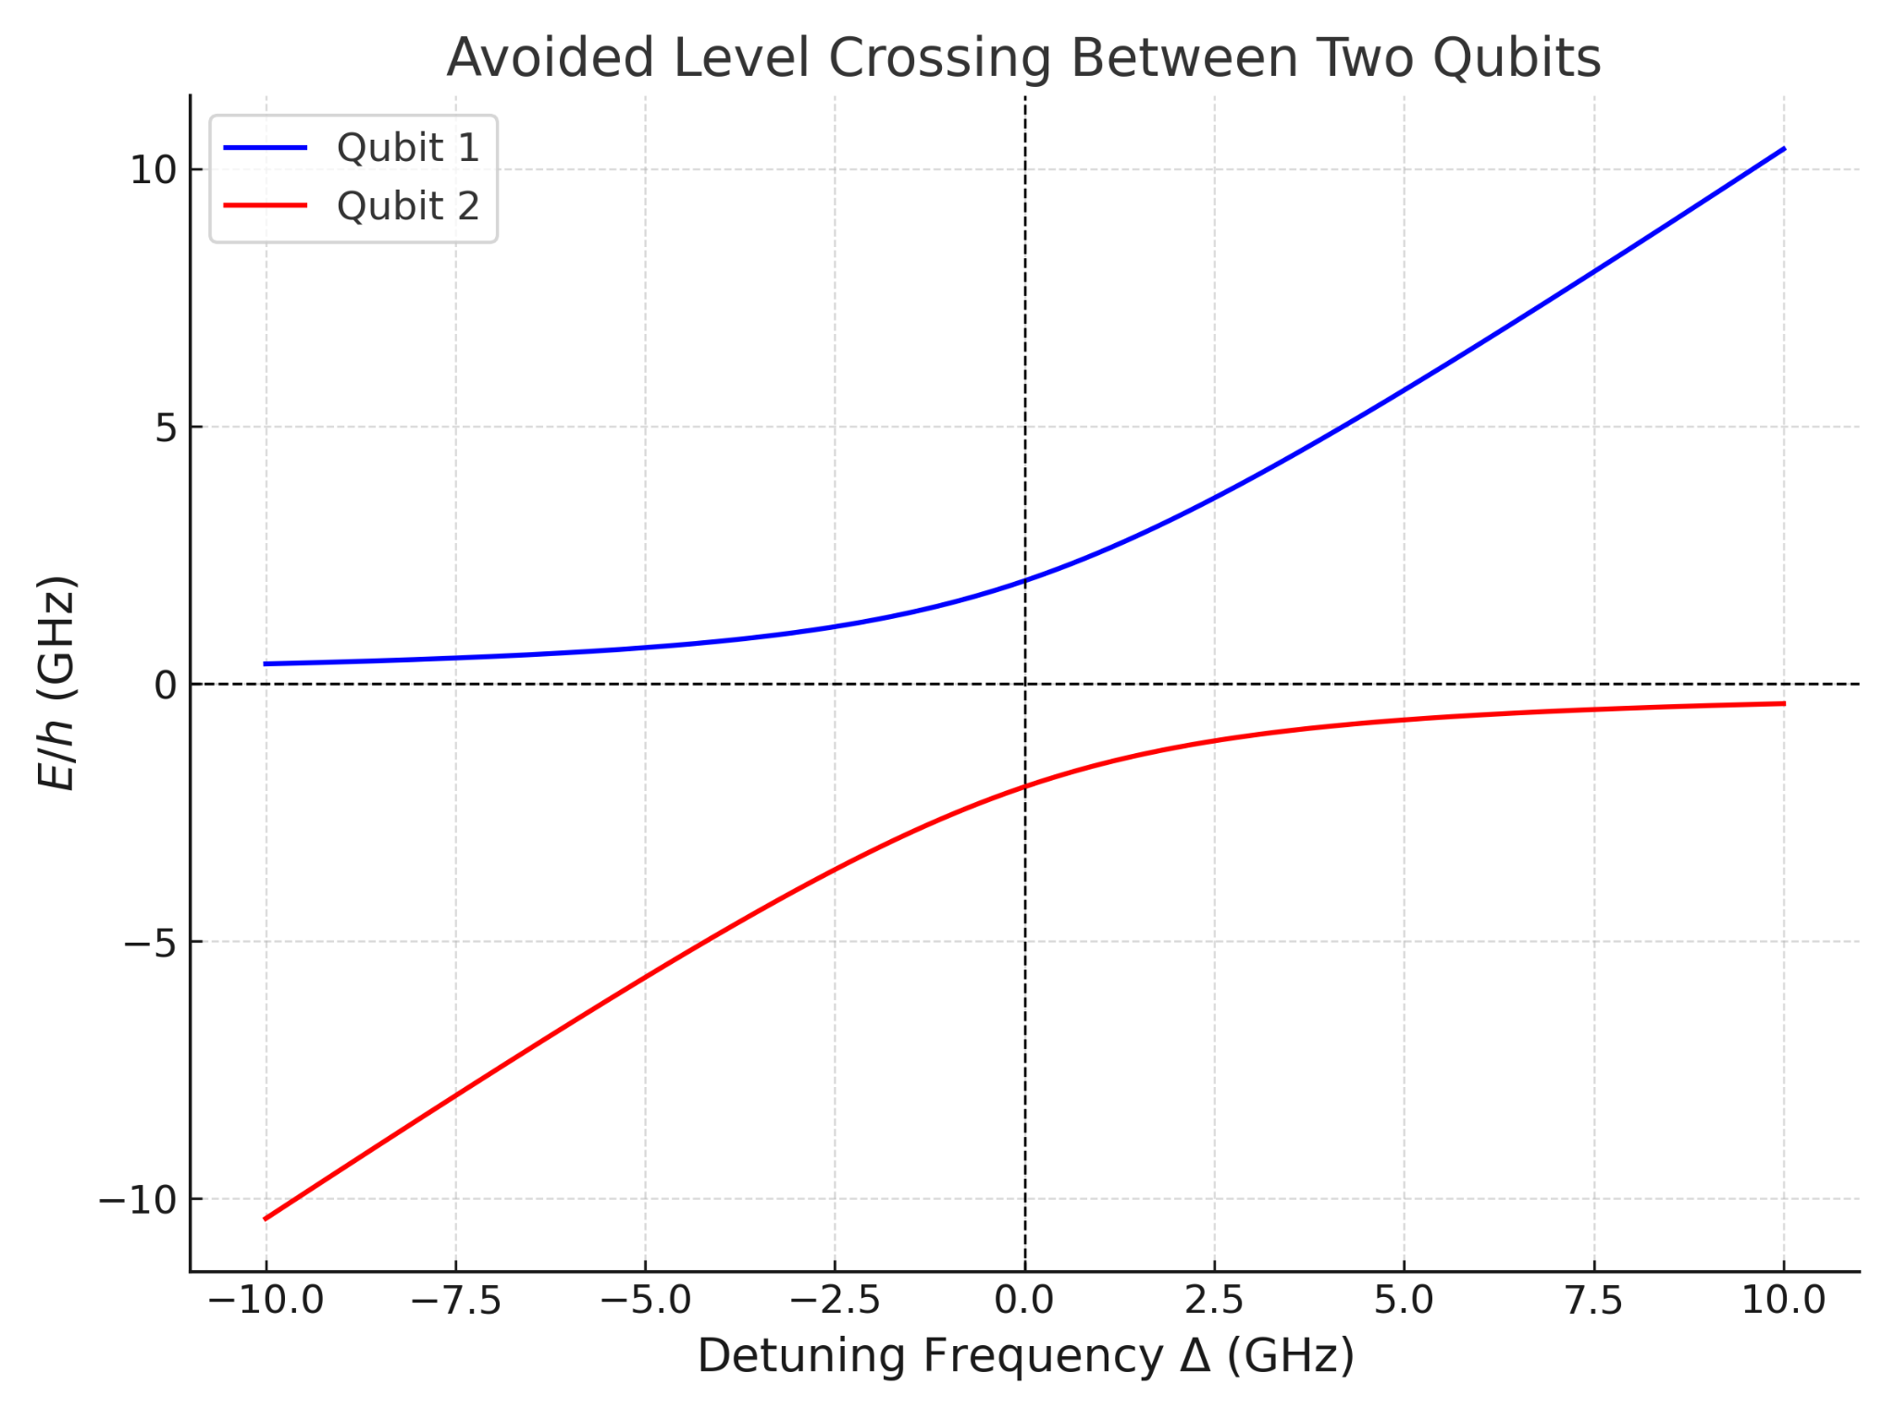
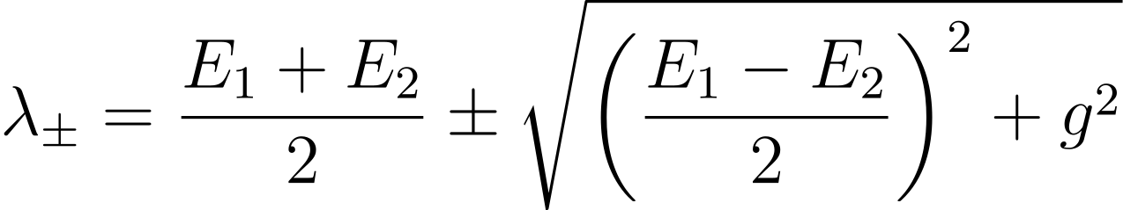
g

Slide 11
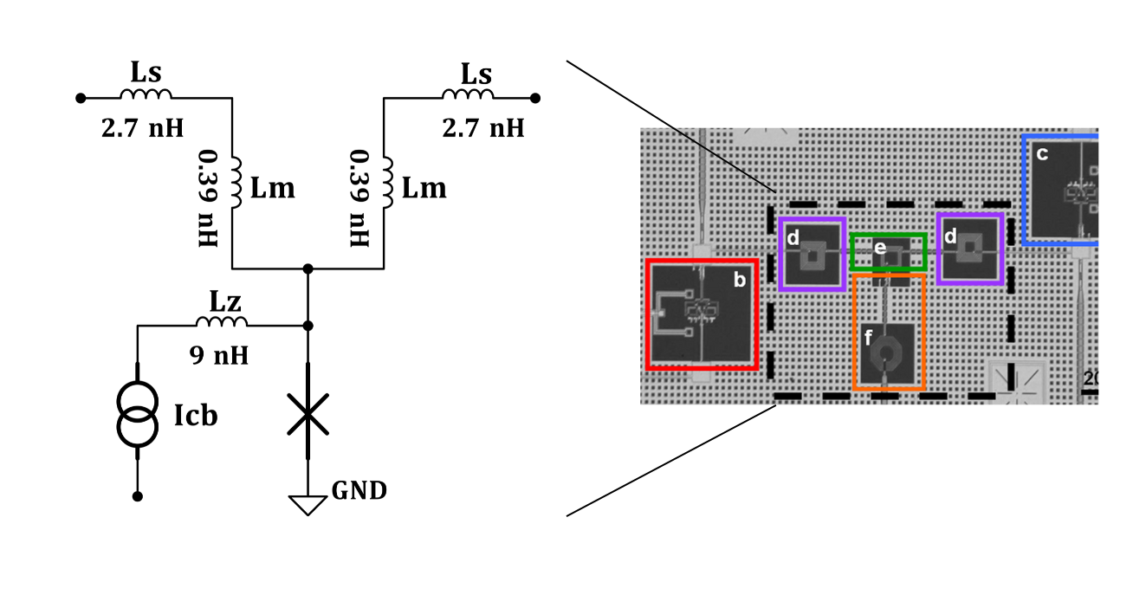
Tunable Coupler architecture
Speed of Control
Real-time Fine-Tuned
Low Crosstalk

Slide 12
Research Statement
2. Current methods for simulating and analyzing quantum processor layout designs are limited in their ability to accurately model complex interactions and optimize qubit arrangements for large-scale systems.

Slide 13
Objectives
Layout preparation
Activate layout components to apply LOM protocol
Check for low-cross talk

Slide 14

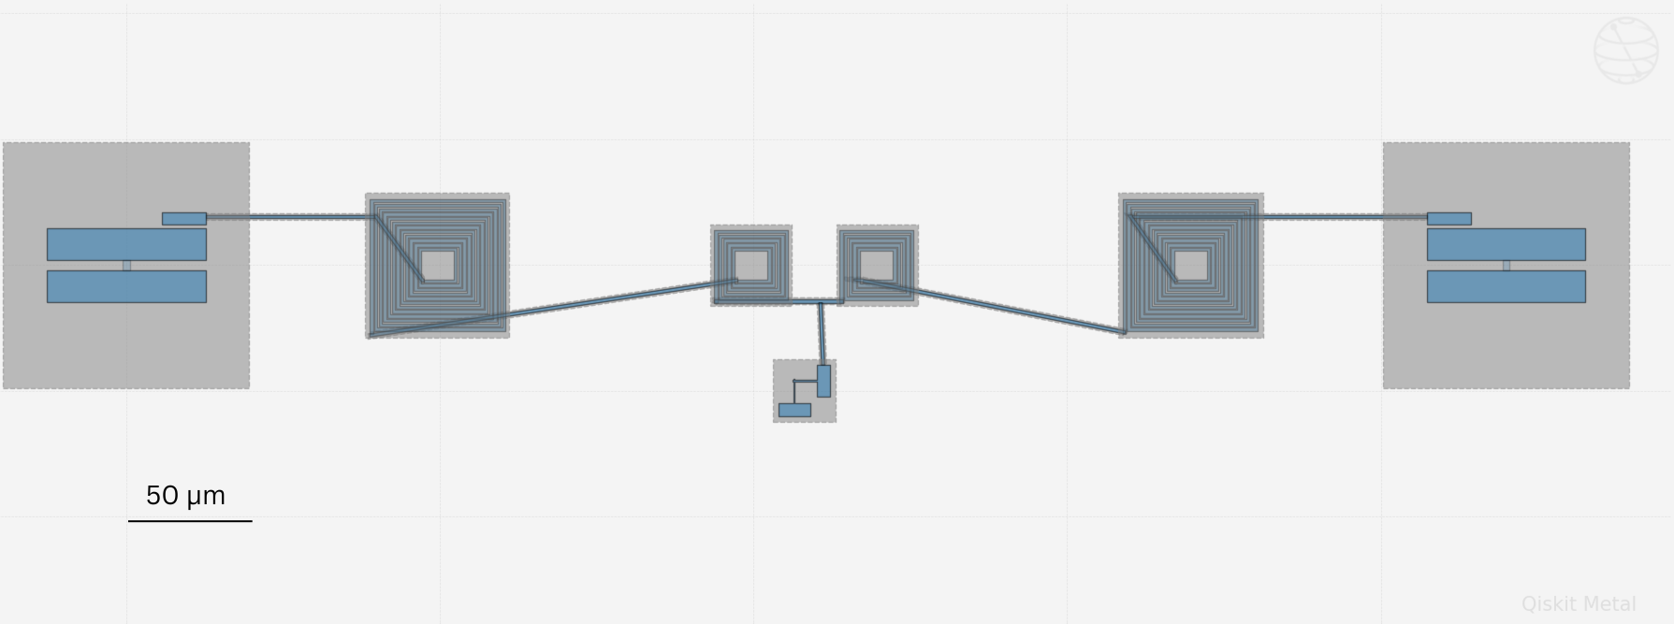
1- Layout
Qubit 1
Inductors Networks
Qubit 2
JJ

Slide 15
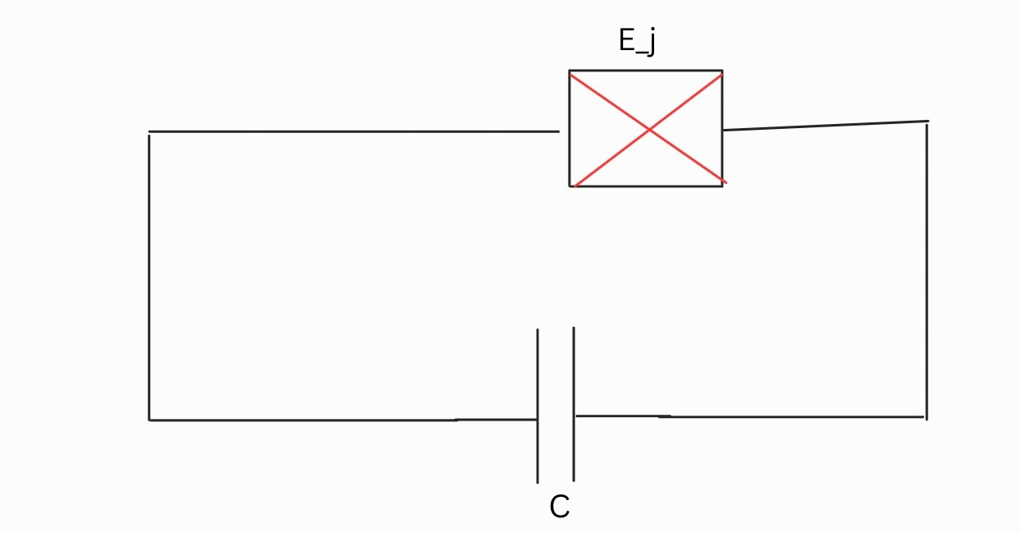
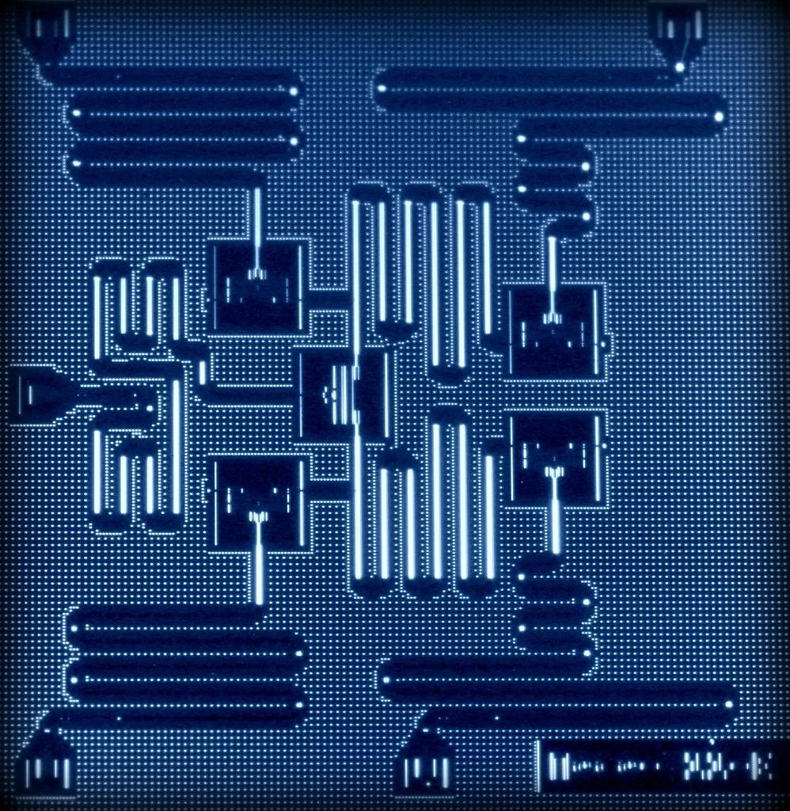
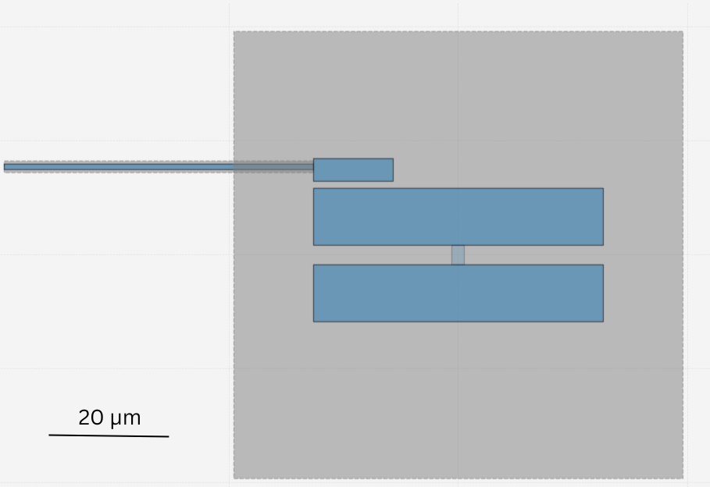
Transmon Qubit
https://shorturl.at/fvtYm

Slide 16
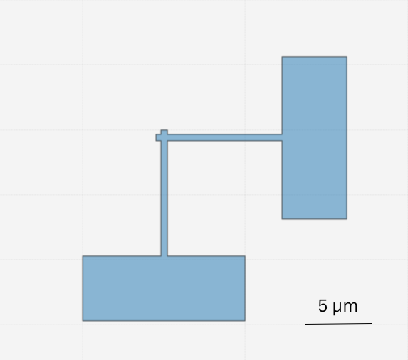
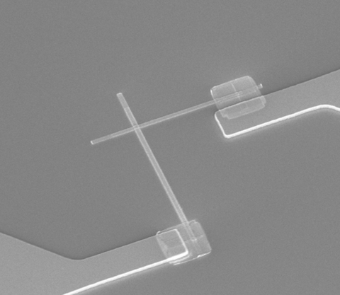
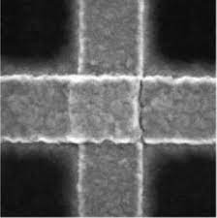
2. Manhattan Josephson Junction

Slide 17
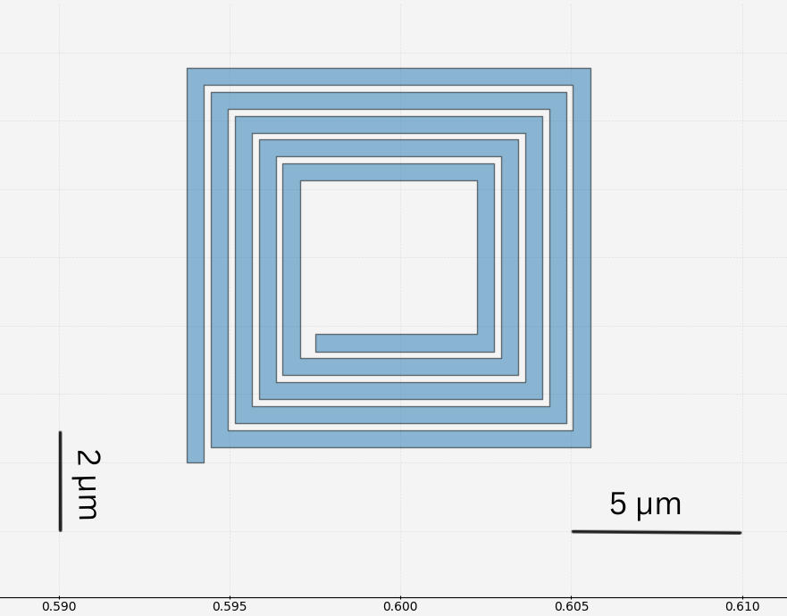
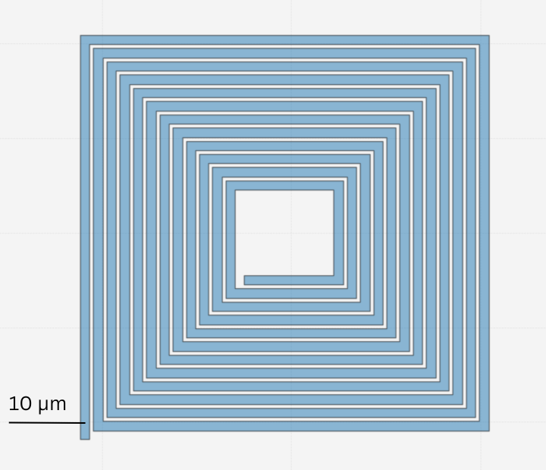
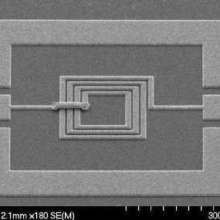
3. Planer Spiral Square Inductor

Slide 18
2- Lumped Model Oscillator
Efficient computational protocol
Convert distributed effects to discrete effects.
Harness graph theory in Network analysis

Slide 19
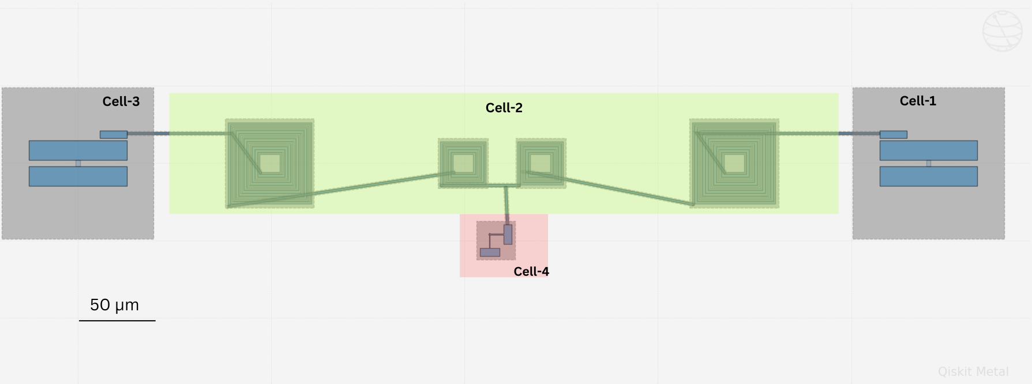
Step 1. Partition Device Into Cells
^{Ĥ0}
^{Ĥ2}
^{Ĥ1}
^{Ĥ0}
^{Ĥ1}
^{Ĥ0}
^{Ĥ1}
^{Ĥ1}
^{Ĥ0}

Slide 20
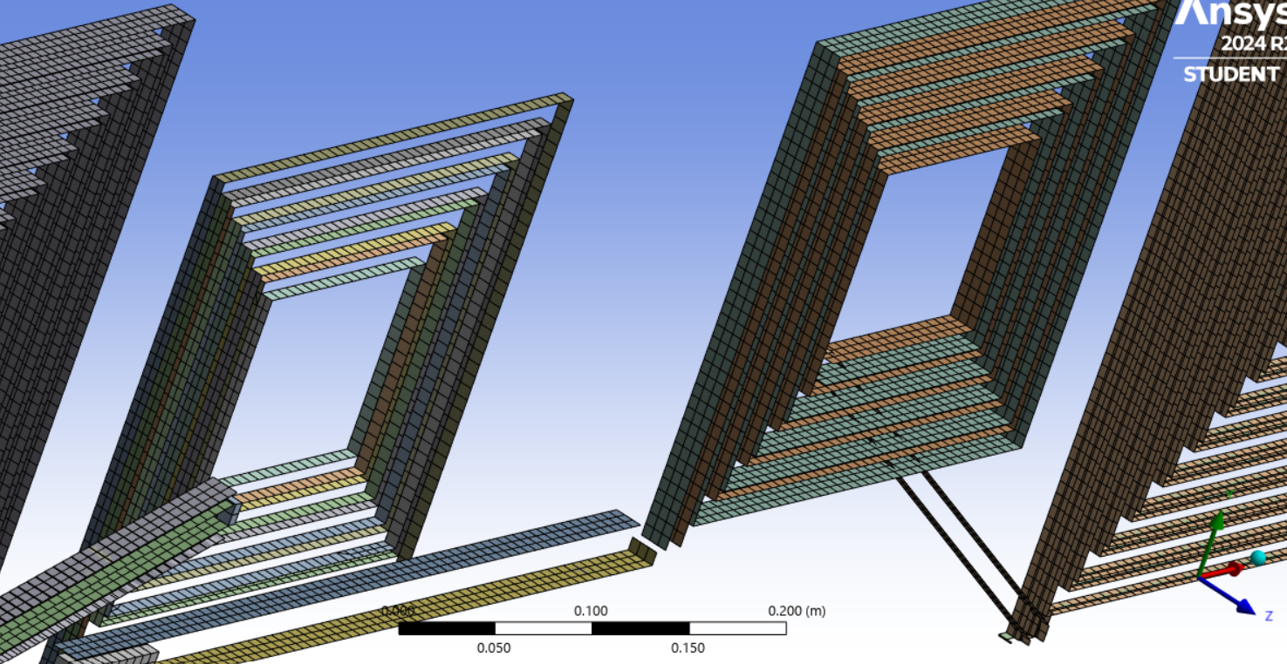
Step 2. Simulate Individual Cell - EM parameters extraction

Slide 21
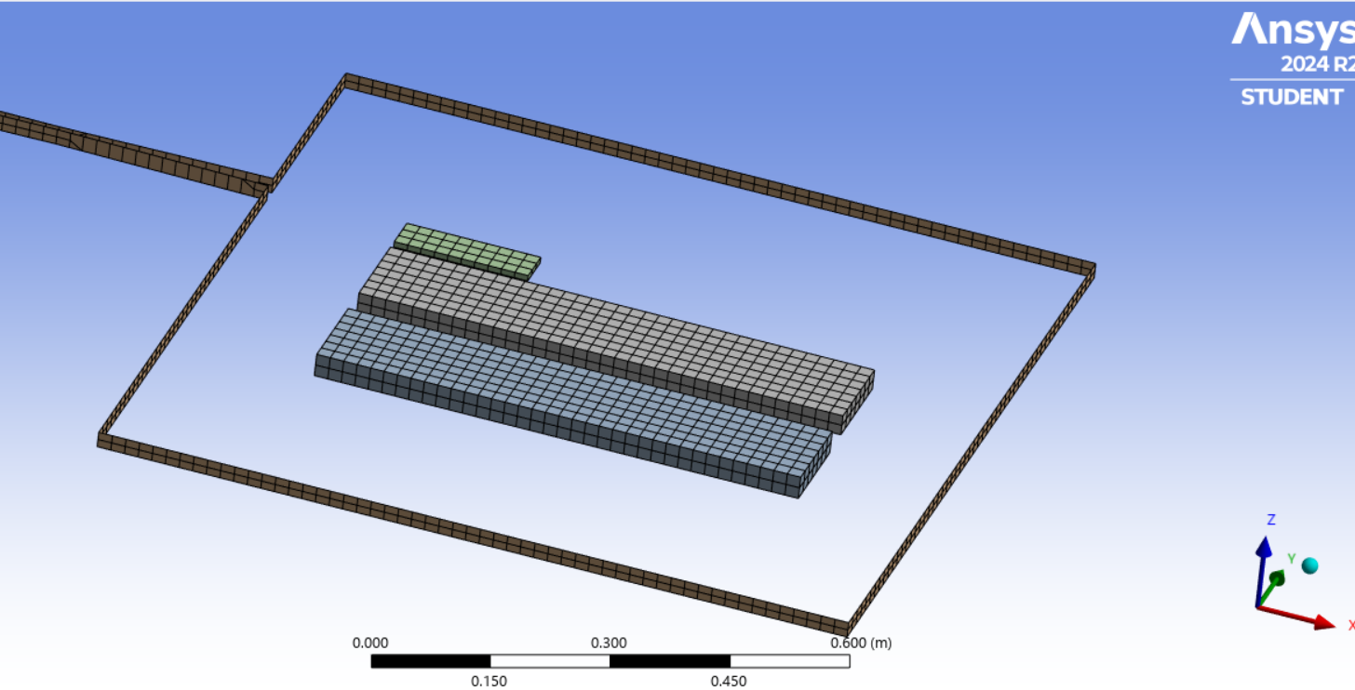

Slide 22
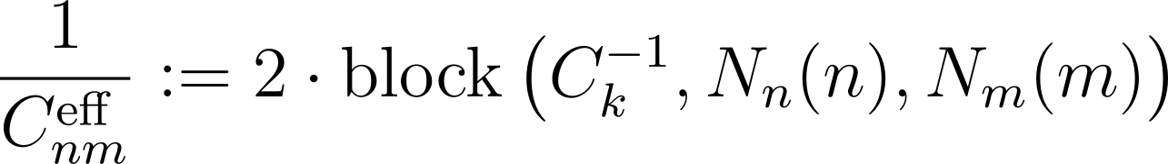
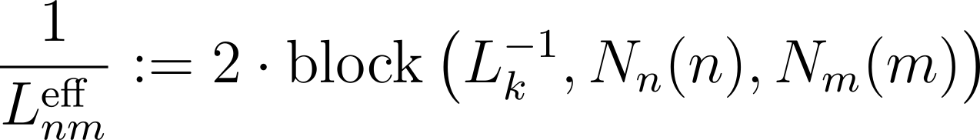
Step 3. Assemble The Composite-System H
C_{n} = ∑ C_{n,cell,} L_{n}⁻¹ = ∑ L⁻¹ _{n, cell}
Rank deficient matrices
2. Dressing

Slide 23
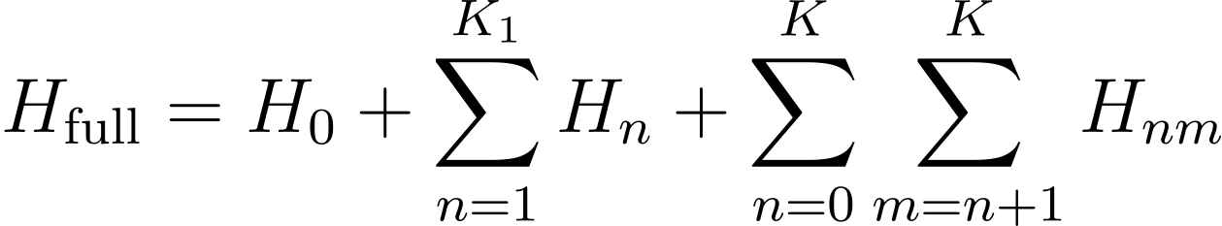
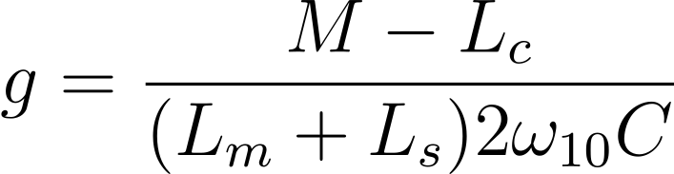
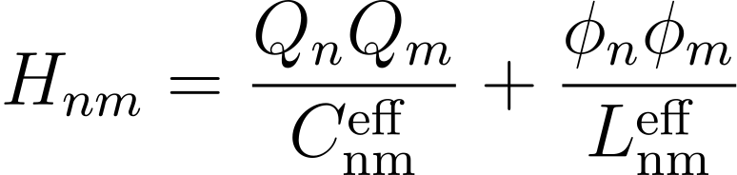
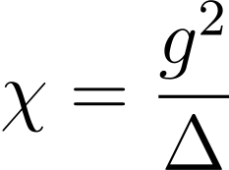
Step 3. Extract Hamiltonian Parameters
3. Diagonalize the Full Hamiltonian: assuming Harmonic oscillator eigenfunction.
, Dispersive shift

Slide 24
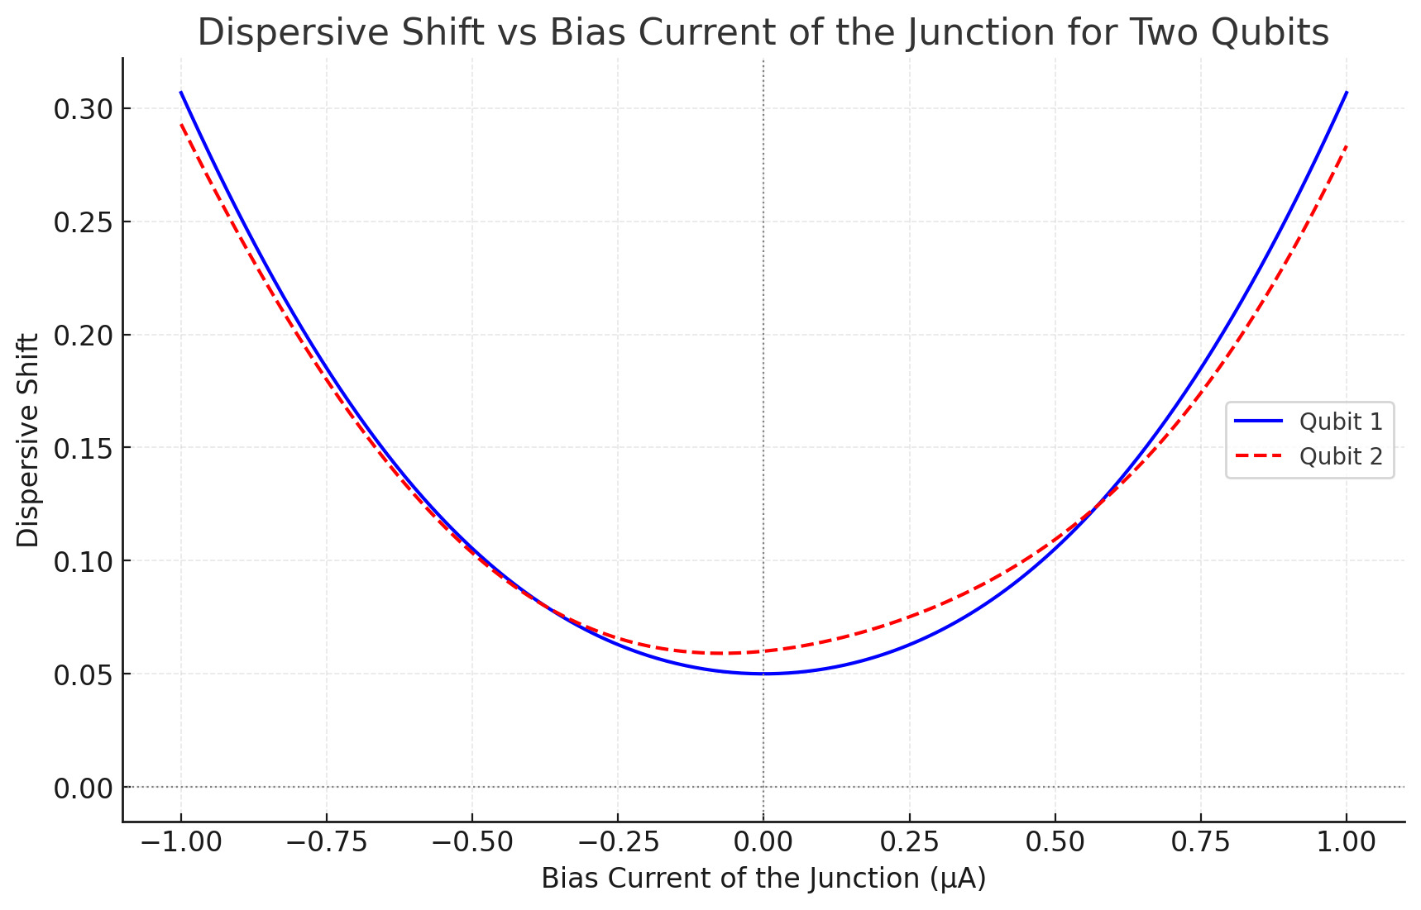

Slide 25
Thank you !
Please don’t hesitate to ask questions

